Slide 1
Module 6
Hypothesis Testing

Slide 2
Introduction
Hypothesis testing is a statistical method used to determine if there is enough evidence in a sample data to draw conclusions about a population.
It involves formulating two competing hypotheses, the null hypothesis (H0) and the alternative hypothesis (Ha), and then collecting data to assess the evidence.

Slide 3
Hypothesis testing and its types
Hypothesis testing is a statistical method used to make inferences about a population based on sample data.
It involves formulating two hypotheses:
the null hypothesis (H0), which represents the default assumption, and
the alternative hypothesis (Ha), which contradicts H0.
The goal is to assess the evidence and determine whether there is enough statistical significance to reject the null hypothesis in favor of the alternative hypothesis.

Slide 4
Types of hypothesis testing:
One-sample test: Used to compare a sample to a known value or a hypothesized value.
Two-sample test: Compares two independent samples to assess if there is a significant difference between their means or distributions.
Paired-sample test: Compares two related samples, such as pre-test and post-test data, to evaluate changes within the same subjects over time or under different conditions.
Chi-square test: Used to analyze categorical data and determine if there is a significant association between variables.
ANOVA (Analysis of Variance): Compares means across multiple groups to check if there is a significant difference between them.

Slide 5
Steps of hypothesis testing
Formulate the hypotheses: State the null hypothesis (H0) and the alternative hypothesis (Ha) based on the research question.
Set the significance level: Determine the acceptable level of error (alpha) for making a decision.
Collect and analyze data: Gather and process the sample data.
Compute test statistic: Calculate the appropriate statistical test to assess the evidence.
Make a decision: Compare the test statistic with critical values or p-values and determine whether to reject H0 in favor of Ha or not.
Draw conclusions: Interpret the results and communicate the findings in the context of the research question.

Slide 6
P Value
In hypothesis testing, the p value is used to indicate whether the results obtained after conducting a test are statistically significant or not.
It also indicates the probability of making an error in rejecting or not rejecting the null hypothesis.This value is always a number between 0 and 1

Slide 7
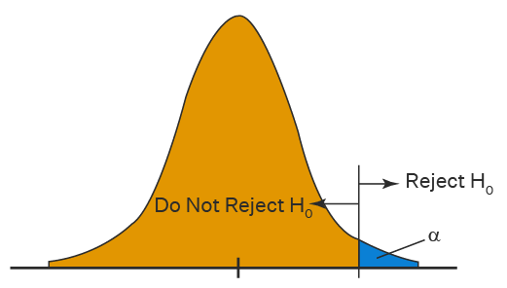

One Tailed Hypothesis Testing
One tailed hypothesis testing is done when the rejection region is only in one direction
Right Tailed Hypothesis Testing
This test is used to check whether the population
parameter is greater than some value.
The null and alternative hypotheses for this test are given as follows:

Slide 8

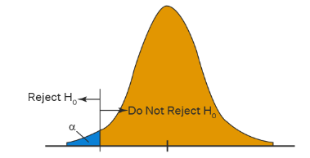
One Tailed Hypothesis Testing
Left Tailed Hypothesis Testing
It is used to check whether the population parameter is less
than some value. The hypotheses for this hypothesis testing can be written as follows:

Slide 9

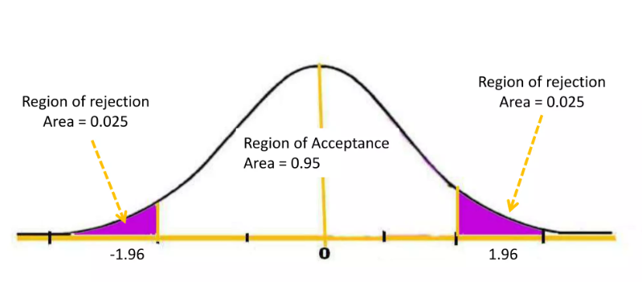
Two Tailed Hypothesis Testing
The two-tailed test is used when it needs to be determined if the population parameter is assumed to be different than some value. The hypotheses can be set up as follows:

Slide 10
Type I & Type II Errors
You decide to get tested for COVID-19 based on mild symptoms. There are two errors that could potentially occur:
Type I error (false positive): the test result says you have coronavirus, but you actually don’t.
Type II error (false negative): the test result says you don’t have coronavirus, but you actually do.
The probability of making a Type I error is the significance level, or alpha (α), while the probability of making a Type II error is beta (β).
These risks can be minimized through careful planning in your study design.

Slide 11
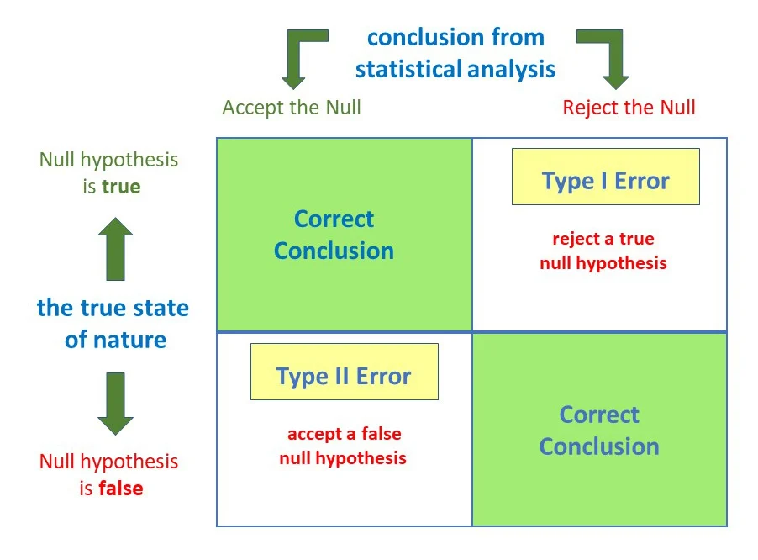
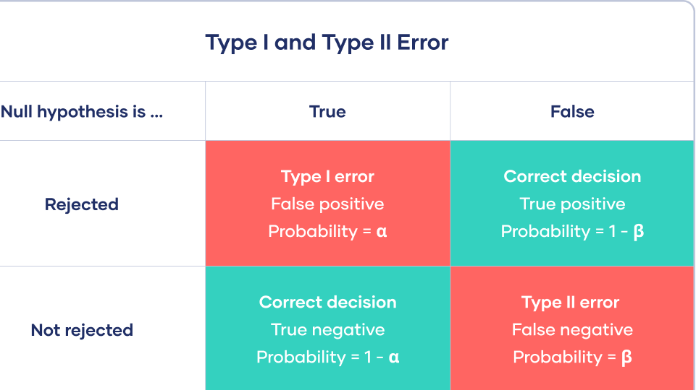
Type I & Type II Errors

Slide 12
Student's ‘t’ distribution
The t-distribution, also known as Student’s t-distribution, is a way of describing data that follow a bell curve when plotted on a graph, with the greatest number of observations close to the mean and fewer observations in the tails.
It is used for estimating population parameters for small sample sizes or unknown variances.
The variance in a t-distribution is estimated based on the degrees of freedom of the data set (total number of observations minus 1).

Slide 13
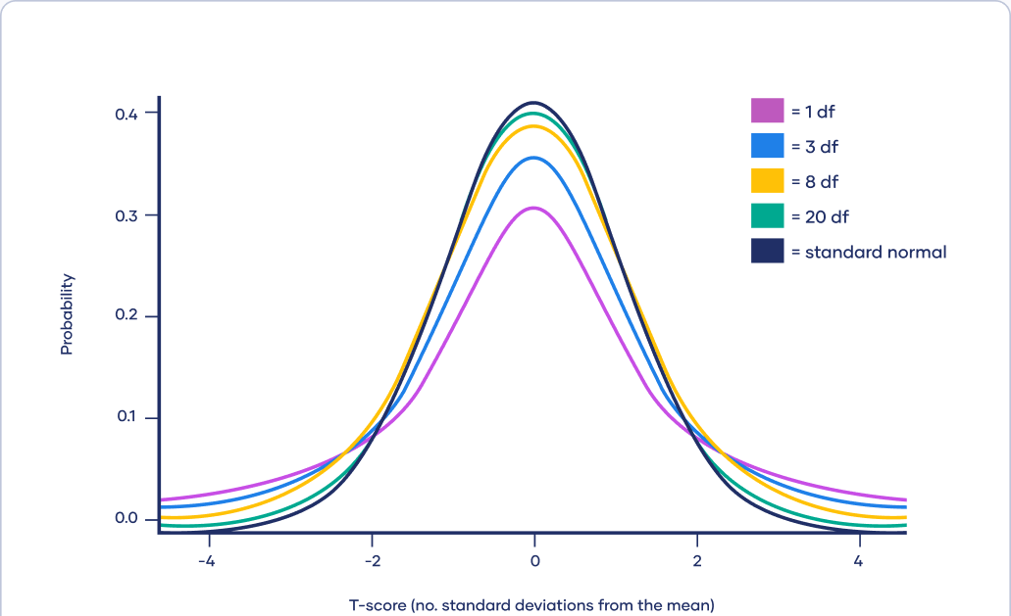
Student's ‘t’ distribution
As the degrees of freedom (total number of observations minus 1) increases, the t-distribution will get closer and closer to matching the standard normal distribution, a.k.a. the z-distribution, until they are almost identical.
Above 30 degrees of freedom, the t-distribution roughly matches the z-distribution. Therefore, the z-distribution can be used in place of the t-distribution with large sample sizes.
The z-distribution is preferable over the t-distribution when it comes to making statistical estimates because it has a known variance. It can make more precise estimates than the t-distribution, whose variance is approximated using the degrees of freedom of the data.

Slide 14
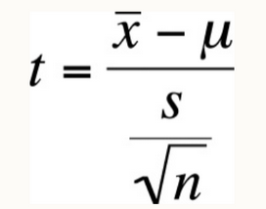
Student's ‘t’ distribution
Let x have a normal distribution with mean ‘μ’ for the sample of size ‘n’ with sample mean x̄ and the sample standard deviation ‘s’, then the t variable has student’s t-distribution with a degree of freedom, d.f = n – 1. The formula for t-distribution is given by;
t = t-score,
x̄ = sample mean
μ = population mean,
s = standard deviation of the sample,
n = sample size
The T-score, also known as the t-value or t-statistic, is a standardized score that quantifies how many standard deviations a data point or sample mean is from the population mean. It is commonly used in statistical hypothesis testing, particularly in scenarios where the sample size is small or the population standard deviation is unknown.

Slide 15
Properties of the t-Distribution
The variable in t-distribution ranges from -∞ to +∞ (-∞ < t < +∞).
t- distribution will be symmetric like the normal distribution if the power of t is even in the probability density function(pdf).
For large values of ν(i.e. increased sample size n); the t-distribution tends to a standard normal distribution. This implies that for different ν values, the shape of t-distribution also differs.
The t-distribution is less peaked than the normal distribution at the center and higher peaked in the tails. From the above diagram, one can observe that the red and green curves are less peaked at the center but higher peaked at the tails than the blue curve.
The value of y(peak height) attains highest at μ = 0 as one can observe the same in the above diagram.
The mean of the distribution is equal to 0 for ν > 1 where ν = degrees of freedom, otherwise undefined.
The median and mode of the distribution is equal to 0.
The variance is equal to ν / ν-2 for ν > 2 and ∞ for 2 < ν ≤ 4 otherwise undefined.

Slide 16
Problem
A random sample of size 16 has mean 53, sum of squares of deviation of the observation from their mean is 135. Can this sample be regarded as drawn from a population having mean of 56
Sol=> H0= there is no difference in mean of sample and mean of population
t=4, v=15
t0.05=2.131
t>t0.05
Difference between mean of sample and mean of population is significant, hence H0 is rejected.
Hence this sample can not be regarded as drawn from the population of mean 56

Slide 17
Problem 2
The mean weekly sale of a powder in a supermarket was 146.3 kg. After a special advertising campaign, mean weekly sales in 22 of its branches increased to 153.7 kg with a standard deviation of 17.2 kg. Was the advertising campaign successful?
Sol=> H0= Advertising campaign was not successful

Slide 18
Subtype I(C) : Testing the significance of the difference between means of two samples [Dependent]
Problem 1:
To verify whether a course in mathematics improved the performance or not. Two test were given to 12 participants (one before and the other after the course). Marks of the test before the course were 44, 40, 61, 52, 32, 44, 70, 41, 67, 72, 53, 72. Marks of the test after the course were 53, 38, 69, 57, 46, 39, 73, 48, 73, 74, 60, 70. Determine whether the course was useful or not.
Sol=> H0= The course is not useful

Slide 19
x1 | x2 | d=x2-x1 | (d-đ)²

Slide 20
Problem 2:
A drug is given to 10 patients and increase in their blood pressure is recorded as 3, 6, -2, 4, -3, 4, 6, 0, 0, 2. Is it reasonable to believe that the drug has no effect on change in blood pressure?
Sol =>
H0: Drug has no effect on change in blood pressure.
d | (d-đ)²

Slide 21
Problem 3:
A certain stimulus administered to each 12 patients,resulted in the following change in the blood pressure 5, 2, 8, -1, 3, 0, 6, -2, 1, 5, 0, 4. Can be concluded in that the injection will be in general accompanied by the blood pressure.
Sol=> H0: There is no change in the blood pressure
d | (d-đ)²

Slide 22
Type II : Large sample (n>30)
Subtype II (A) : Testing the significance of the difference between the mean of sample (x’) and mean of the population (u).
Subtype II (B) : Testing the significance of the difference between the two means (x1’, x2’) of two samples
Level | Two sided | One sided
5% | 1.96 | 1.65
1% | 2.58 | 2.33

